Slide 1




Unreal Expectations
Unreal Expectations
Final Presentation
Midterm Progress Presentation

Slide 2

Mood after this quarter

Slide 3
The Game
Turn-Based Strategy in the legacy of Fire Emblem
Two armies of 5 melee units, one per player
Use your army to crush the other
Map is completely symmetric
Win condition: annihilate other army

Slide 4

Challenges
Learning to work with materials
Managing multiple units on Unreal’s pawn framework
Making Mixamo animations works
UI taking forever

Slide 5
What works
Units have complete state machines including death and combat
Context Menu and Health Bars
Fog of War
Full games can be played through with any number of units on either side

Slide 6
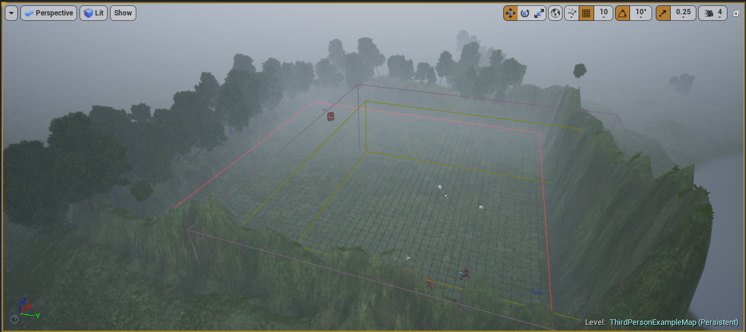
The map

Slide 7
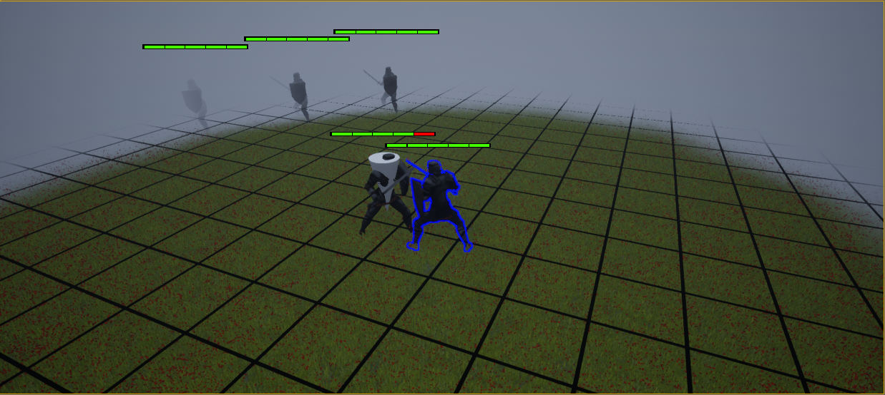
The armies

Slide 8
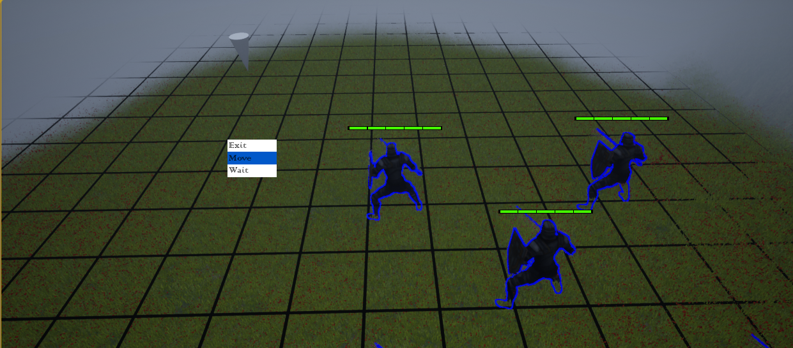
UI

Slide 9
demo

